Slide 1
Sustainability in Food and Drink
UK, 2023

Slide 2
THE MARKET

Slide 3
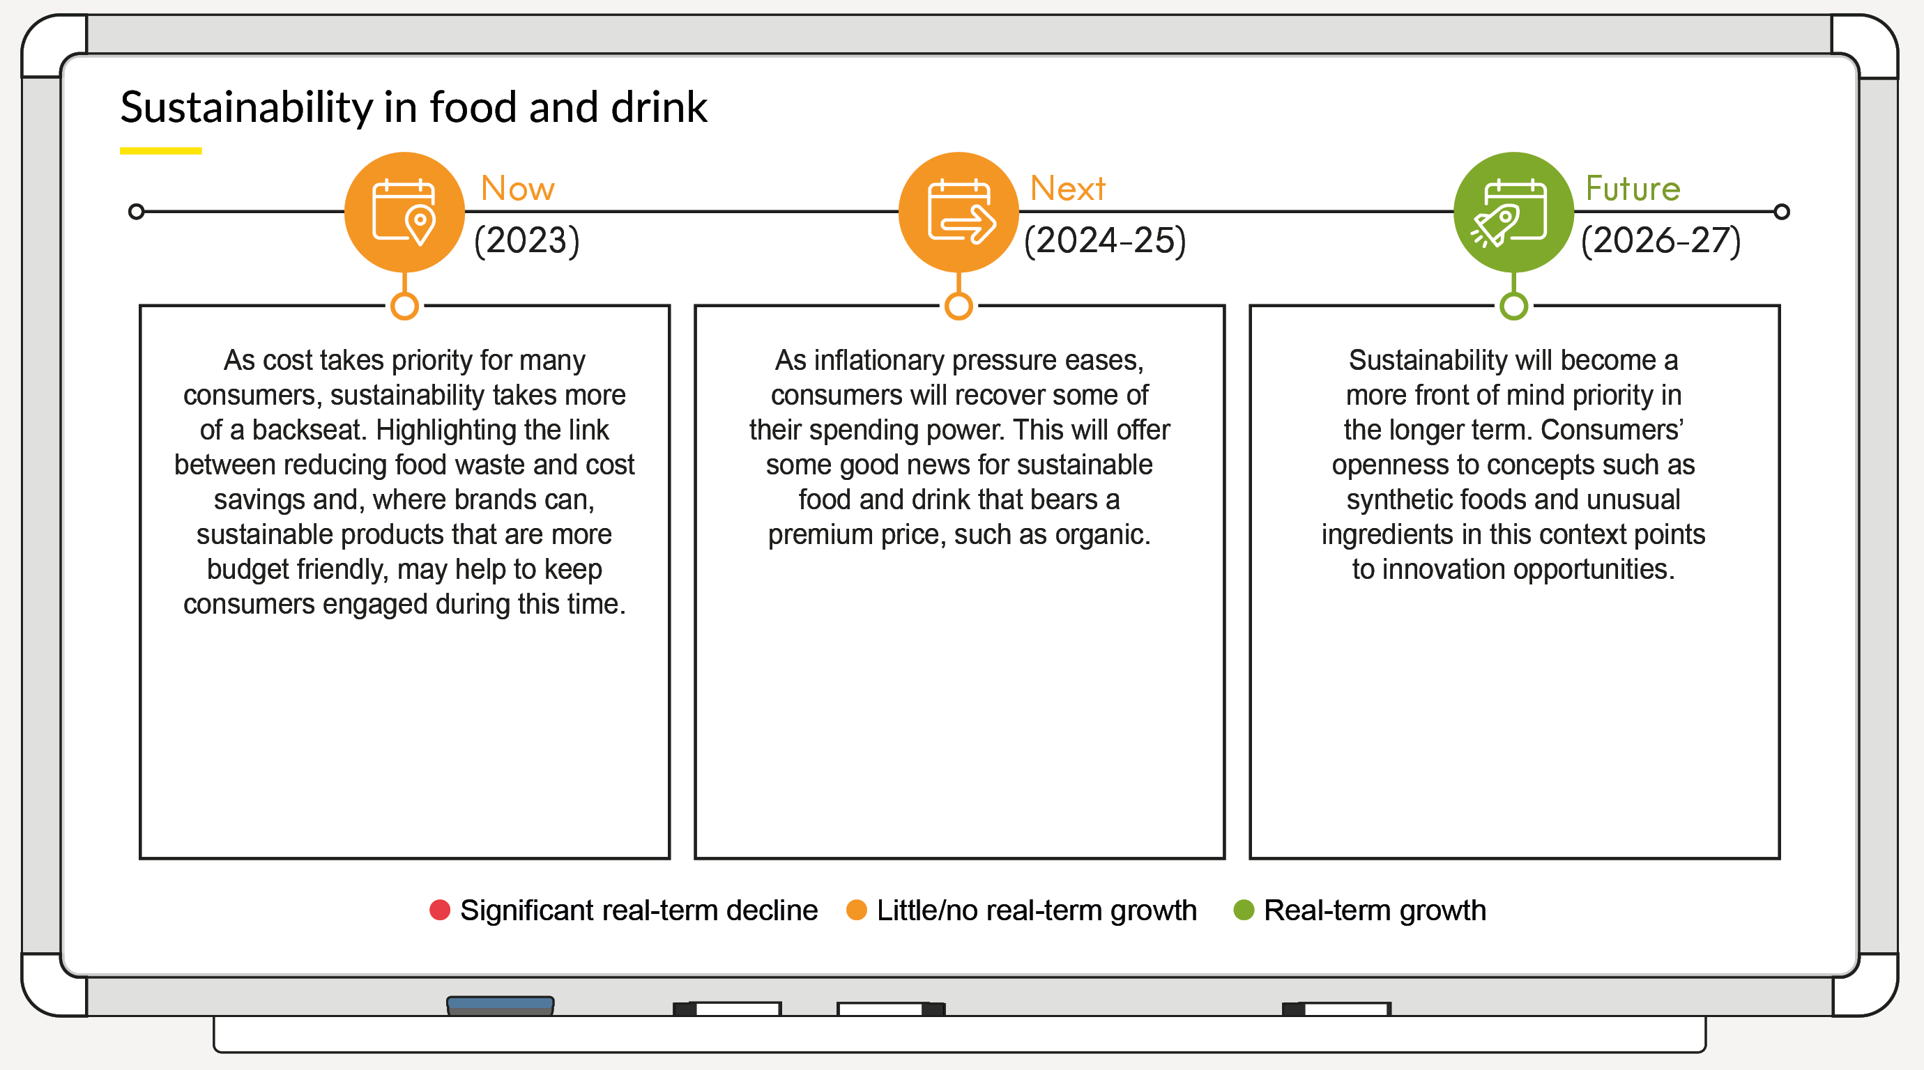
The Five-Year Outlook for Sustainable Food and Drink
Outlook for interest in sustainability in food and drink, 2023-27
TRAFFIC LIGHT TABLE TO BE ADDED HERE
Source: Mintel, prepared in January 2023

Slide 4
Household Financial Wellbeing
Household financial wellbeing index, 2016-2022
Base: 2,000 internet users aged 16+
Source: Kantar Profiles/Mintel, January 2016-November 2022

Slide 5
Impact of Rising Cost Living on Sustainable Food and Drink
Agreement that rising cost living will make the sustainability of food and drink products less important, 2022
“Do the following statements apply to you?"
Base: 1,564 internet users aged 16+ who choose food/drink products with sustainability claims
Source: Kantar Profiles/Mintel, August 2022

Slide 6
THE CONSUMER

Slide 7
Frequency of Choosing Sustainable Food and Drink Products
Frequency of choosing sustainable food and drink products, by age and financial situation, 2022
“I intentionally choose food and drink products with sustainability related claims over others for…"
Base: 1,984 internet users aged 16+ who buy food and drink
Source: Kantar Profiles/Mintel, August 2022

Slide 8
Barriers to Choosing Food/Drink Products with Sustainability Claims Over Others More Often
Barriers to choosing food/drink products with sustainability claims over others more often, 2022
“Why don’t you choose food and drink products with sustainability claims over others/choose them more often? Please select all that apply."
Base: 1,831 internet users aged 16+ who don’t choose food/drink products with sustainability claims for all the products they buy
Source: Kantar Profiles/Mintel, August 2022

Slide 9
Most Appealing Sustainability-related Claims
Most appealing sustainability-related claims when choosing food/drink, 2022
“Which of the following claims would most encourage you to choose one food or drink product over another? Please select up to 3."
Base: 1,564 internet users aged 16+ who choose food/drink products with sustainability claims
Source: Kantar Profiles/Mintel, August 2022

Slide 10
Behaviours Related to Sustainability in Food
Behaviours related to sustainability in food, 2022
“Do the following statements apply to you?"
Base: 1,564 internet users aged 16+ who choose food/drink products with sustainability claims
Source: Kantar Profiles/Mintel, August 2022

Slide 11
Attitudes towards Sustainability in Food
Attitudes towards sustainability in food, 2022
“Do you agree or disagree with the following statements?"
Base: 2,000 internet users aged 16+
Source: Kantar Profiles/Mintel, August 2022

Slide 12
Consumer Priorities When Buying Food and Drink Products
Consumer priorities when buying food and drink products, 2022
“Which of the following are most important to you when buying food and drink products? Please select up to 5."
Base: 2,000 internet users aged 16+
Source: Kantar Profiles/Mintel, August 2022

Slide 13
COMPANIES AND BRANDS

Slide 14
Food and Drink Products with Sustainability-related Claims
Share of UK food and drink product launches with an environmentally-friendly product claim, 2017-22
Source: Mintel GNPD

Slide 15
Food and Drink Launches with Sustainable Resource-related Claims
Share of UK food and drink product launches with sustainable resource-related claims, 2017-22
Source: Mintel GNPD

Slide 16

Angharad Goode
Research Analyst
info@mintel.com
mintel.com

